Slide 1
Efficiency and responsiveness in the supply chain

Slide 2
INTRODUCTION
  A supply Chain should be designed and built to find the right balance between:
      - responsiveness (meeting customer specific needs) and
      - efficiency (Low- cost)

Slide 3
II. SUPPLY CHAIN DEFINITION
A supply chain is a network of organisations working together to control and manage the flow of materials from suppliers to end-users (Chopra, 2007)
  Organisations include designers, suppliers, manufacturers, distributors, warehouses, transporters, retailers and customers.
  Materials include
    tangibles (raw materials, supplies, components, work in process and finished goods etc.)
    Intangibles (information, knowledge, processes etc.)

Slide 4
The Supply Chain of Apple iPhone (Apple)
Singapore | Taiwan | USA | China
Apple
Product design
Samsung
. CPU
. Video processing . chips
Infineon
Baseband Communications
hardware
Primax Electronics
Digital Camera modules
Foxconn International
Internal Circuits
The Apple
Shenzhen
Assemble hardware, hold inventory, handles the pick, pack & ship
Entery Industrial
Connectors
Cambridge Silicon
Bluetooth chipsets
Broadcomm
Touch screen
Umicron Technology
Printed Circuits Boards
Catcher Technology
Metal castings
Marvell
801.11 specific parts

Slide 5
III. THEORETICAL FRAMEWORK OF SUPPLY CHAIN
Competitive
Strategy
Supply Chain
Strategy
Supply chain structure
Suppliers
Customers
Where
How
What
Facilities
Transportation
Inventory
Logistical Drivers
Information
Sourcing
Pricing
Cross-functional Drivers
ACHIEVE 2 AIMS
Efficiency and Responsiveness

Slide 6
To achieve its strategic fit a firm’s supply chain
should seek the balance between Responsiveness
and efficiency that best meet the needs of the firm’s
competitive Strategy.
To achieve the balance between responsiveness and
efficient, a firm should co-ordinate its logistical
drivers (facilities, transportation & inventory) with its
functional drivers (information, sourcing & pricing)

Slide 7
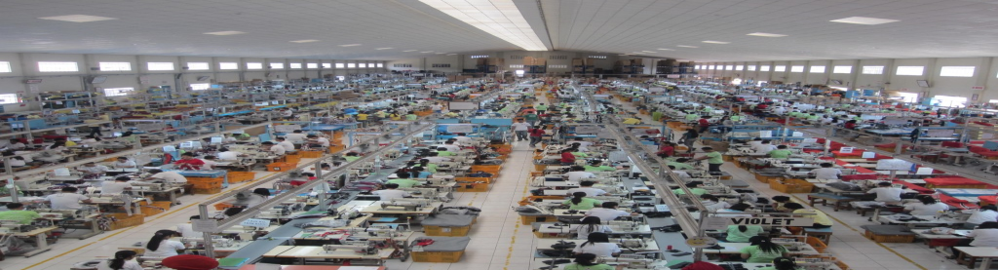
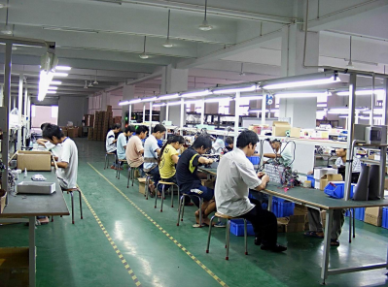


A- LOGISTICAL DRIVERS
(i) Facilities: where inventory is:
        transformed (production plant) or
        Held or stored (warehouse of distribution centre) or
        sold (retail outlet)
    Centralised (Efficiency)
    Decentralised (Responsiveness)

Slide 8
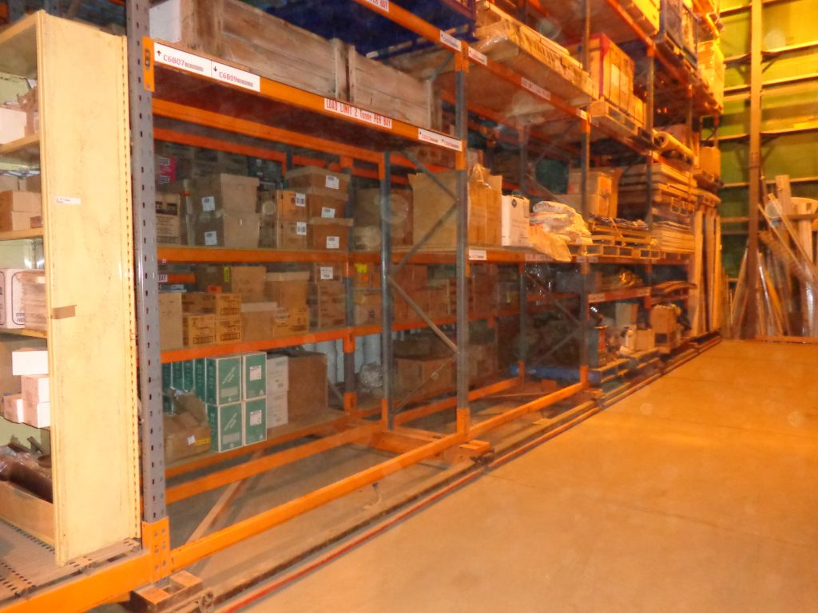
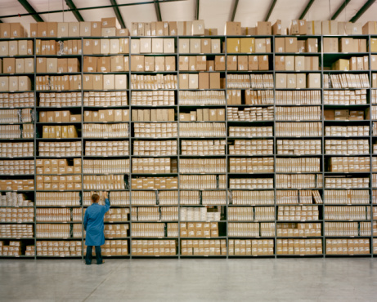
  (ii) Inventory: raw materials, works-in-process, finished goods held throughout the supply chain (anything moving through SC)
    Short (Efficient)
    Large (Responsive)

Slide 9
V. SUPPLY CHAIN DRIVERS
DRIVERS
FUNCTIONAL
LOGISTICAL
Information
Facilities
Sourcing
Inventory
Pricing
Transportation
Supply chain management coordinates its logistical drivers with functional drivers to achieve a trade-off between efficiency & responsiveness.

Slide 10

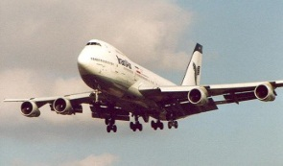
  (iii) Transportation : physical movement of inventory through the
  supply chain.
    slower (efficiency)
    Faster (responsiveness)

Slide 11
IV. AIMS OF A SUPPLY CHAIN
SUPPLY CHAIN SPECTRUM
AIMS
EFFICIENCY
RESPONSIVENESS
- Focus on low-cost products
- Low service
- Limit variety of products
- Product standardisation
- exploiting economies of scale
- Long lead time
- Price likely to be low
Focus on customers’ specific needs
- High service Level
- Produce a large variety
- Product innovation
- Exploiting economies of scope.
- Short lead time
Price likely to be high
An ideal supply chain aims at achieving a trade-off between efficiency and responsiveness.

Slide 12
Supply chain management coordinates its logistical drivers with functional drivers to achieve a trade-off between efficiency & responsiveness
Facilities
Efficient or responsive
Inventory
Efficient or responsive
Transportation
Efficient or responsive
Information
Efficient or responsive
Sourcing
Efficient or responsive
Pricing
Efficient or responsive

Slide 13
B- FUNCTIONAL DRIVERS
(i) Information:
    Targeted (responsiveness)
    Wide (efficient)
(ii) Sourcing: Buying inputs needed for production
    Collective (efficiency)
    buying to order (responsiveness)
(iii) Pricing: determining the price to charge customers.
  Every day low pricing ( efficiency)
  Differential pricing (responsiveness)

Slide 14
III. Illustrations
How Wal-Mart’s coordination of its logistical and functional drivers.
Facilities
Uses centrally located distribution centres
Build retail stores only where demand is sufficient
Efficiency
Responsiveness
Keeps a low level of inventory through cross-docking (transfer from warehouse dock to trucks)
Inventory
Efficiency
Transport
Owns its fleet of trucks to allow supplies all the time
Responsiveness
Information
Is the leader in the use if IT enabling the feeding and sharing of information across its supply chain
Efficiency
Responsiveness
Sourcing
Deals with a few sources supplying large orders allowing them to achieve huge economies of scale
Efficiency
Pricing
Practices “every day low pricing” (EDLP) principle to customer needs
Responsiveness and efficiency

